Slide 1
Rad tokom šeste nedelje
I dalje vežbate upotrebu sadašnjeg perfekta.
Vaš zadatak je da pažljivo pročitate pitanja i da u sveske napišete najpre kratke, a zatim pune potvrdne ili odrične odgovore.
Kad to završite slikajte i pošaljite na google učionicu.
Primer:
Have you ever been a guest at a surprise party?
Yes, I have.
I have been a guest at a surprise party.
Ili:
No, I haven’t.
I have never been a guest at a surprise party.

Slide 2
Rad tokom šeste nedelje - IOP 1
Prepisati deset pitanja sa slajdova u svesku.
Kad to završite slikajte i pošaljite na google učionicu.
Rad tokom šeste nedelje - IOP 2
Odabrati i prepisati pet pitanja u svesku, slikati i poslati na google učionicu.

Slide 3
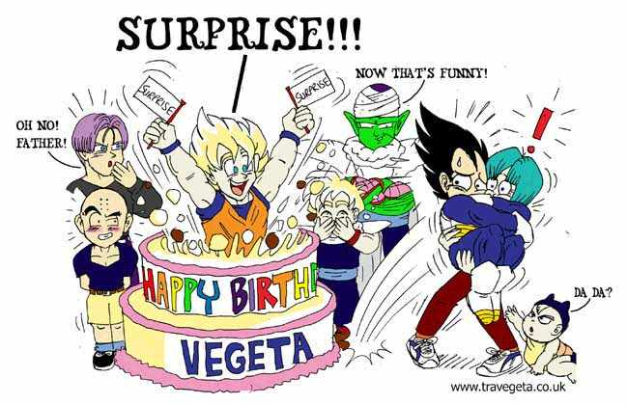
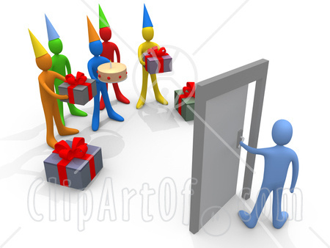
Have you ever been a guest at a surprise party? *guest - gost

Slide 4
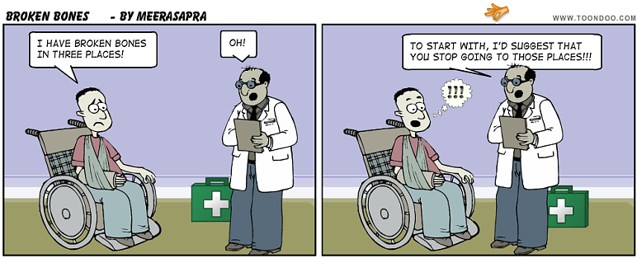
Has your mother/father ever broken a bone?

Slide 5
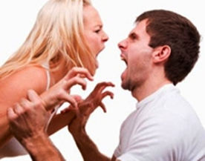
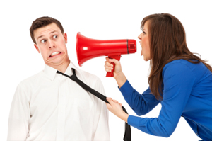
Have you ever called your friend by the wrong name? *wrong - pogrešan

Slide 6
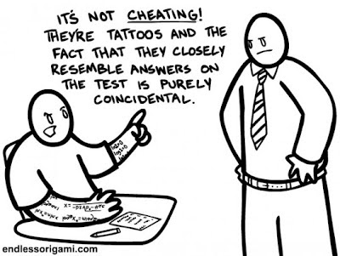
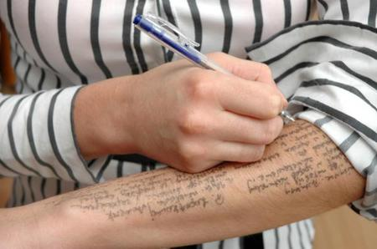
Have you ever cheated on an exam? *cheat – varati *exam – test, ispit

Slide 7


Have you ever given a false excuse to get out of something you didn't want to do? *a false excuse – lažan izgovor

Slide 8
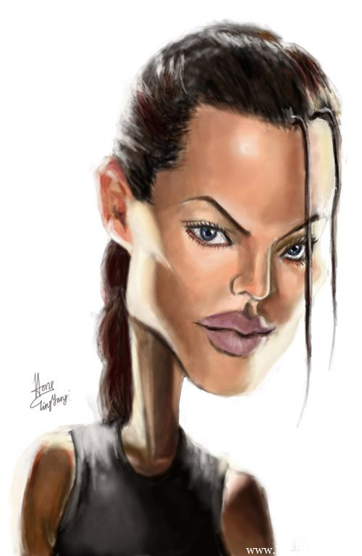
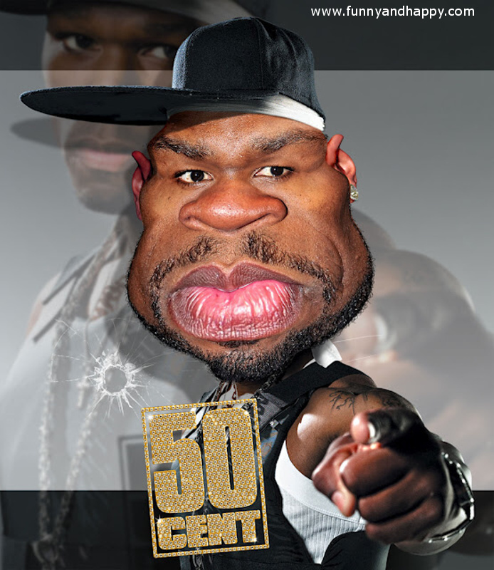
Have you ever met a celebrity? * celebrity – poznata ličnost

Slide 9
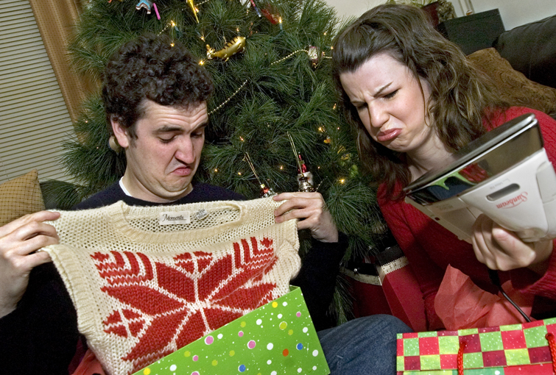
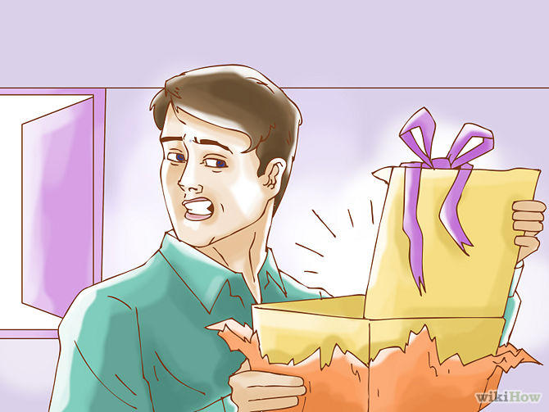
Have your parents ever given you a present that you really hated? *hate - mrzetii

Slide 10
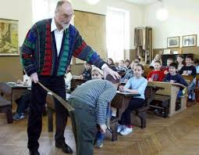
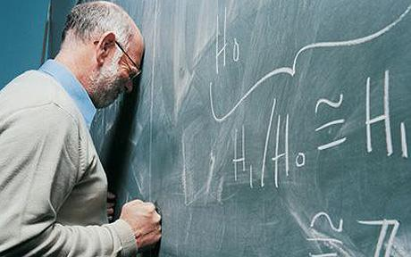
Have you ever played a joke on one of your teachers? *play a joke – našaliti se

Slide 11
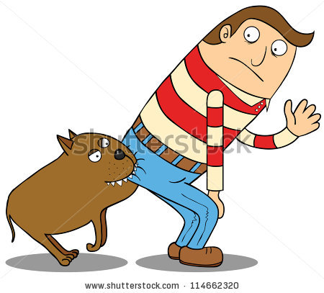
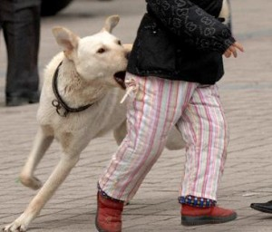
Have your friend/brother/sister ever been bitten by a dog?

Slide 12
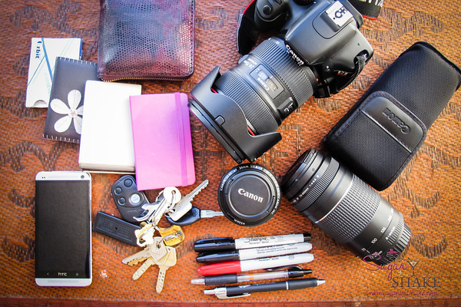
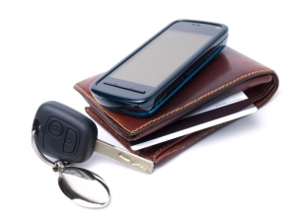
Have you ever lost something important? (money, your wallet, documents, cellphone, keys)

Slide 13


